Slide 1

Functions, Arrays, Vectors
Creating and Using Functions, Arrays in C++, STL Vectors
SoftUni Team
Technical Trainers
Software University
http://softuni.bg

Slide 2
Functions – Calling, Declaring, Defining
C++ Arrays
Arrays in Programming
Declaring & Initializing
Usage with Functions
STL Vectors
Dynamic-size arrays
Using std::vector

Slide 3
Have a Question?
sli.do
#cpp-fundamentals

Slide 4
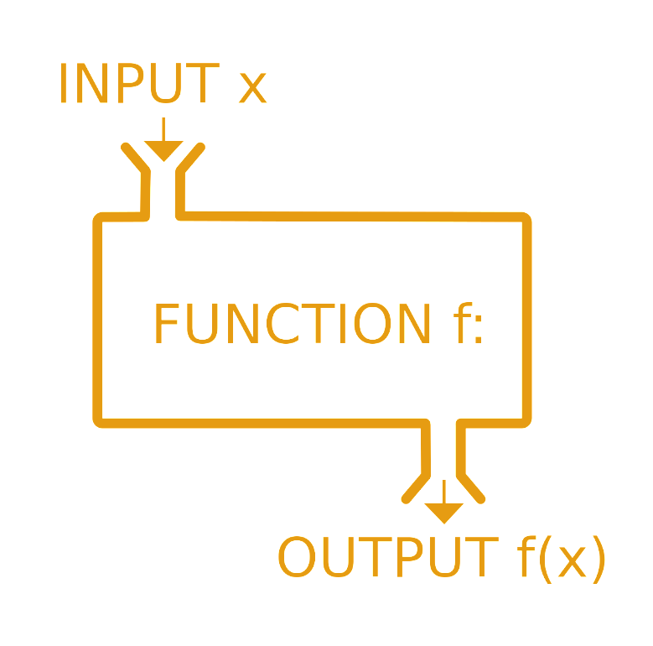
Functions
Calling, Defining, Implementing

Slide 5
What is a Function?
A named block that performs a specific task
Can be called from other code
Can take parameters and return a value
Also known as methods
main() is a function
int main()
{
return 0;
}

Slide 6
Calling Functions
Using functions is almost like using variables, however:
You write () after them, which could contain parameters
Most functions return a value – you can use it in an expression
Just like you would use a variable's value
void functions don’t have/return values, they only execute code
#include<iostream>
void helloWorld() {
std::cout << “Hello World!” << std::endl;
}
int main() {
helloWorld();
return 0;
}

Slide 7
Calling Functions
LIVE DEMO

Slide 8
Declaring and Defining Functions
Declare the function
return type (i.e. value)
name
parameters
Define the body
always in a block
contains the actual code
Call with name followed by () containing parameters
#include<iostream>
int getMaxValue(int a, int b) {
int maxValue;
if (a > b) maxValue = a;
else maxValue = b;
return maxValue;
}
int main() {
std::cout << getMaxValue(5, 7) << std::end;
return 0;
}

Slide 9
Declaring and Defining Functions
LIVE DEMO

Slide 10
Function Declaration vs. Definition
Declaration – tells the compiler there is such a function
Can be anywhere
Can appear multiple times
Same visibility rules as for variables
Definition – tells the compiler what the function does
Can be declared but not defined – compilation error if called
Declaration – function’s name, return type and
parameters

Slide 11
Declaring vs. Defining Functions
LIVE DEMO

Slide 12
Returning Values from Functions
The return keyword determines the function's return value
return immediately exits the function
Non-void functions must have a return followed by a value
int getMax(int a, int b) {
if (a > b) {
return a;
}
return b;
}

Slide 13
static Variables Inside Functions
static variables live through the entire program, initialized once
static variables can be used inside functions to track state (e.g. How many times a function was called)
void countNumbers(int a = 1, int b = 10) {
static int num = 0;
for (int i = a; i <= b; i++) {
cout << i << endl; num++;
}
cout << “Static int -> ” << num << endl;
}

Slide 14
Static Variables Inside Functions
LIVE DEMO

Slide 15
0 1 2 3 4
… | … | … | … | …
Arrays
Multiple Values Inside One Variable

Slide 16
What are Arrays?
In programming, an array is a sequence of elements
Elements are numbered from 0 to Length-1
Elements are of the same type (e.g. integers)
Arrays have fixed size – cannot be resized
Element index
Array of 5 elements
0 1 2 3 4
… | … | … | … | …
Element of an array

Slide 17
Creating C++ Arrays
Declaring: DataType identifier [arraySize];
C++ arrays have some special initialization syntax
DataType identifier[N] = {elem0, elem1, ..., elemN-1}
There can be less than N elements, but not more
Example: int numbers[5] = {10,9,12,31,15};
Index | 0 | 1 | 2 | 3 | 4
Value | 10 | 9 | 12 | 31 | 15

Slide 18
C++ Array Declaration
C++ Array size must be an integer, known compile-time
i.e. size can be a literal
or a const value/expression
double numbers[7];
const int NumLetters = 26;
char alphabet[NumLetters];

Slide 19
C++ Array Initialization
{} initializes elements (comma-separated values)
if less values than array size -> remaining get default values
if more values than array size -> compilation error
Other rules are the same as for primitives
Can only be initialized once
Can be made const
double values[3] = { 3.14 };
double sameValues[3] = { 3.14, 0, 0 };

Slide 20
0 1 2 3 4
… | … | … | … | …
Creating C++ Arrays
LIVE DEMO

Slide 21
Working with Arrays
Assigning values to the array elements
The Length holds the number of array elements
Accessing array elements by index
The [] operator accesses elements by index
for (int i = 0; i < Length; i++)
numbers[i] = 1;
numbers[5] = numbers[2] + numbers[7];
numbers[10] = 1; // IndexOutOfRangeException

Slide 22
0 1 2 3 4
… | … | … | … | …
Accessing Array Elements
LIVE DEMO

Slide 23
Reading Arrays From the Console
First, read from the console the array length:
Next, create an array of given length and read its elements:
int length = 0;
cin >> length;
Common approach: run a loop to read-in a number of elements
int arr[length];
for (int i = 0; i < length; i++) {
cin >> arr[i];
}

Slide 24
Printing Arrays on the Console
To print all array elements, a for-loop can be used
Separate elements with white space or a new line
int length = 6; // Keep a variable for the array size
double arr[] = { 5.1, 2, -8.8, 6.66, -11, 3 };
for (int i = 0; i < Length; i++) {
// Print each element with white space between them
cout << arr[i] << “ ”;
}
cout << endl;

Slide 25
0 1 2 3 4
… | … | … | … | …
Reading and Printing Arrays
LIVE DEMO

Slide 26
Arrays as Function Parameters
Array parameters are declared the same way arrays are declared
First dimension size can be omitted in array parameter
Usually necessary to add an integer for the size
void printArray(int arr[], int size) {
for (int i = 0; i < size; i++) {
cout << arr[i] << “ “;
}
cout << endl;
}
int main() {
int n[] = { 1, 2, 3 };
printArray(n, 3);
return 0;
}

Slide 27
C++11 Range-Based for Loop
Tired of writing for loops with indices to iterate over an array?
C++11 added a loop for that use-case
Syntax (for arrays): for (DataType element : array)
Body will execute once for each element in the array
On each iteration, element will be the next item in the array
int numbers[] = { 13, 42, 69 };
for (int i : numbers) {
cout << i << endl;
}

Slide 28
0 1 2 3 4
… | … | … | … | …
C++11 Range-Based for Loop
LIVE DEMO

Slide 29

STL Vectors
C++ Dynamically-Sized Arrays

Slide 30
STL Vector Basics
The C++ std::vector class is a resizable array
Has normal array-like access – [] operator
Knows its size (.size()), can add elements (.push_back())
#include<vector>
Acts like a normal variable
Can be assigned like a normal variable
Can be returned from a function

Slide 31
Initializing a Vector
Declaration Syntax: std::vector<T> name;
The vector is initially empty – items need to be added
Call push_back(T element) on the vector to add elements
Can be initialized directly in C++11 with {} syntax
std::vector<int> numbers {13, 42, 69};
std::vector<int> numbers = {13, 42, 69};
std::vector<int> myVector;
for (int i = 0; i < 100; i++) {
myVector.push_back(i + 10);
}

Slide 32
Initalizing STL Vectors
LIVE DEMO

Slide 33
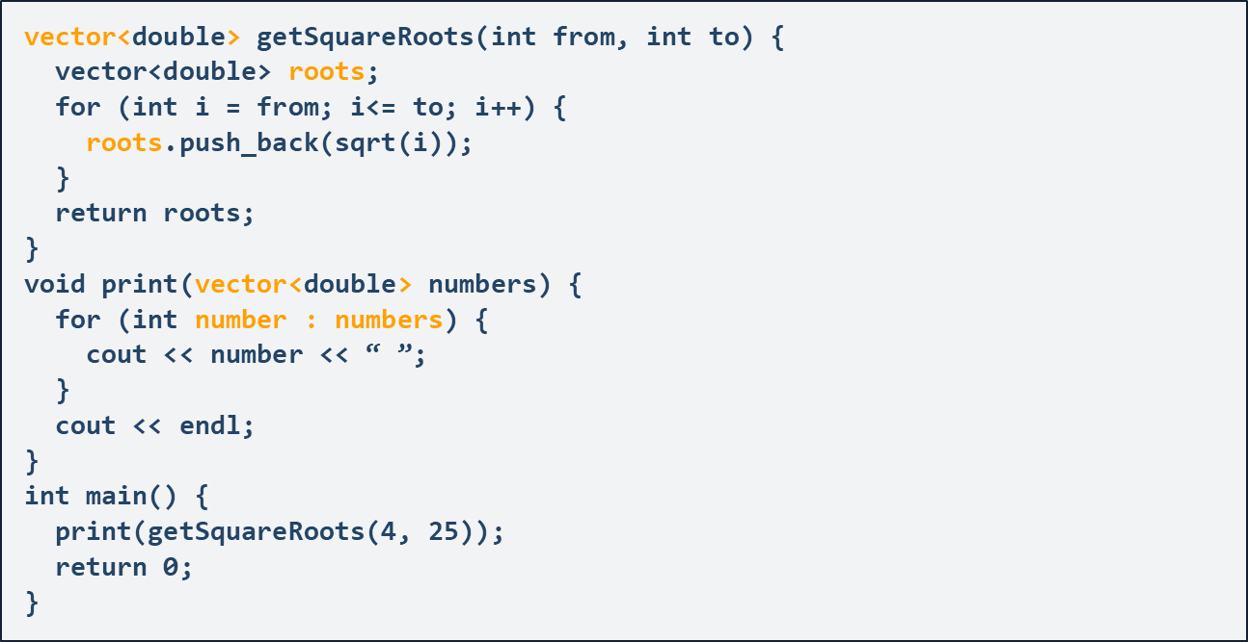
Returning STL Vectors from Functions
Vectors act as normal variables when returned
Function returns a copy

Slide 34
Returning STL Vectors from Functions
LIVE DEMO

Slide 35

Summary
Functions are named, reusable blocks of code
Can accept parameters and return valuesserves key order
Maps map keys to values, preserves key order
Arrays are sequences of numbered elements
STL Vectors are objects that represent arrays which can resize
Can mostly be used of arrays for basic tasks

Slide 37












SoftUni Diamond Partners

Slide 38




SoftUni Organizational Partners

Slide 39

License
This course (slides, examples, demos, videos, homework, etc.) is licensed under the "Creative Commons Attribution-NonCommercial-ShareAlike 4.0 International" license

Slide 40





Trainings @ Software University (SoftUni)
Software University – High-Quality Education, Profession and Job for Software Developers
softuni.bg
Software University Foundation
http://softuni.foundation
Software University @ Facebook
facebook.com/SoftwareUniversity
Software University Forums
forum.softuni.bg

